Slide 1
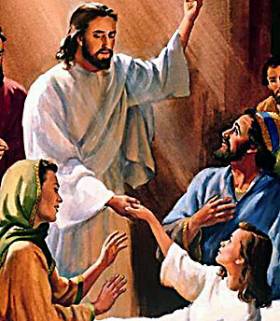
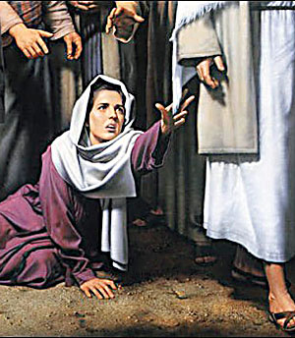
The Daughter of a Ruler
(Highest in Jewish Society)
An ‘Untouchable’ Woman
(Lowest in Jewish Society)
Jesus Loves Everyone the Same

Slide 2
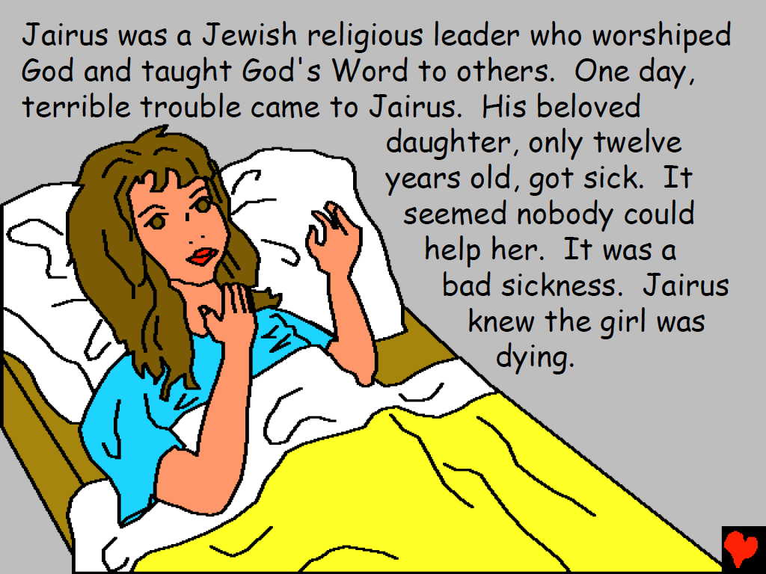

Slide 8
Video: Jesus Heals the Woman with the Issue of Blood
Download Here:
https://www.youtube.com/watch?v=yArWsPS1ZU8

Slide 9
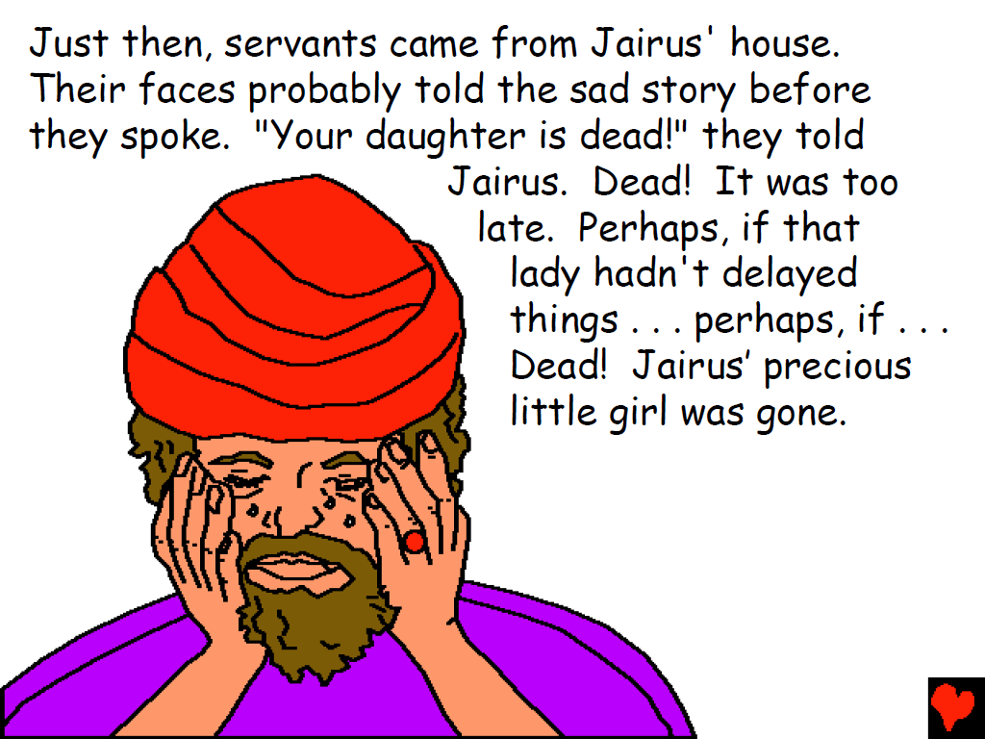

Slide 11
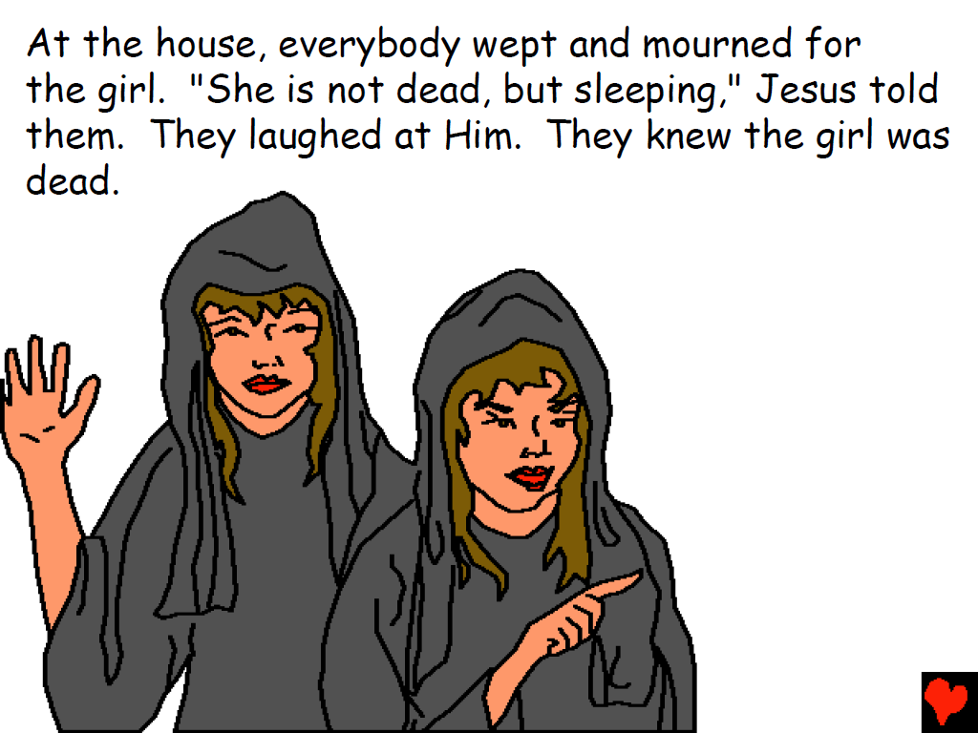

Slide 12
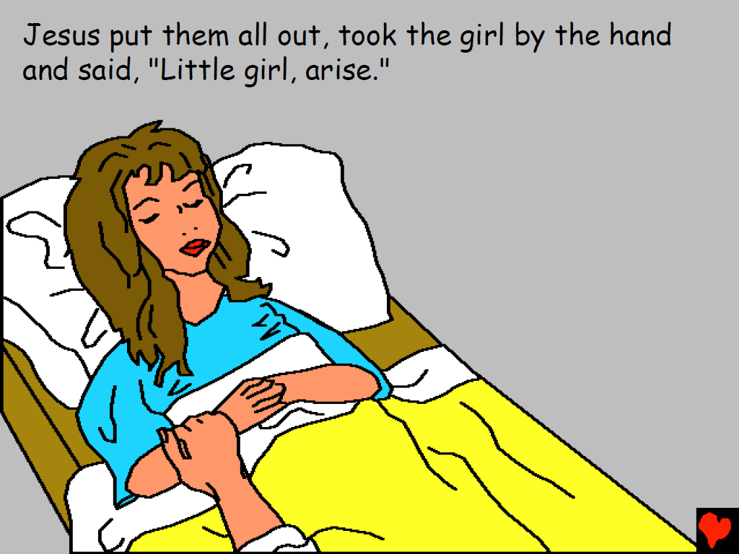

Slide 13
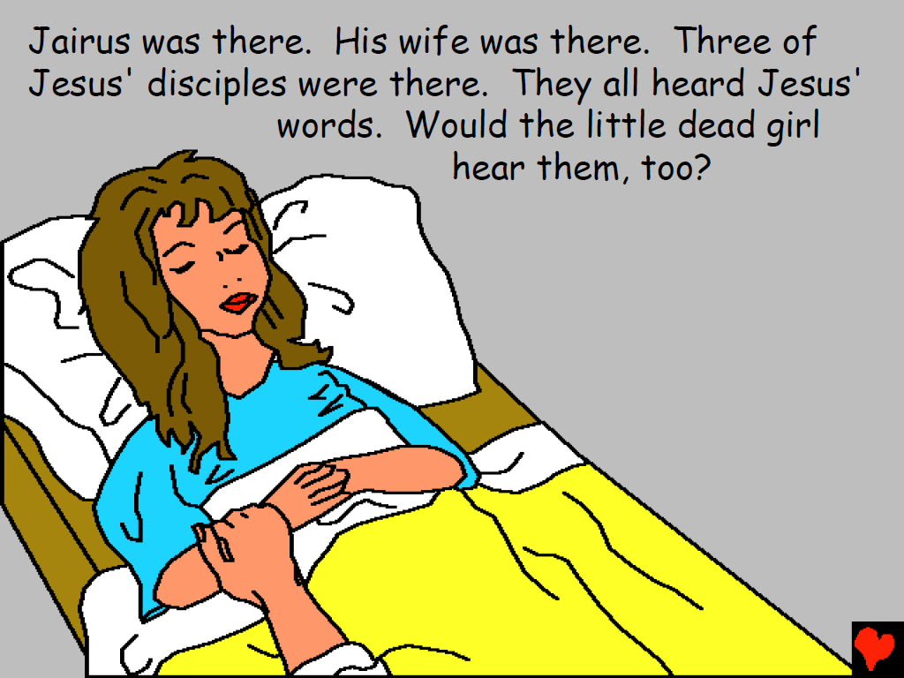

Slide 14
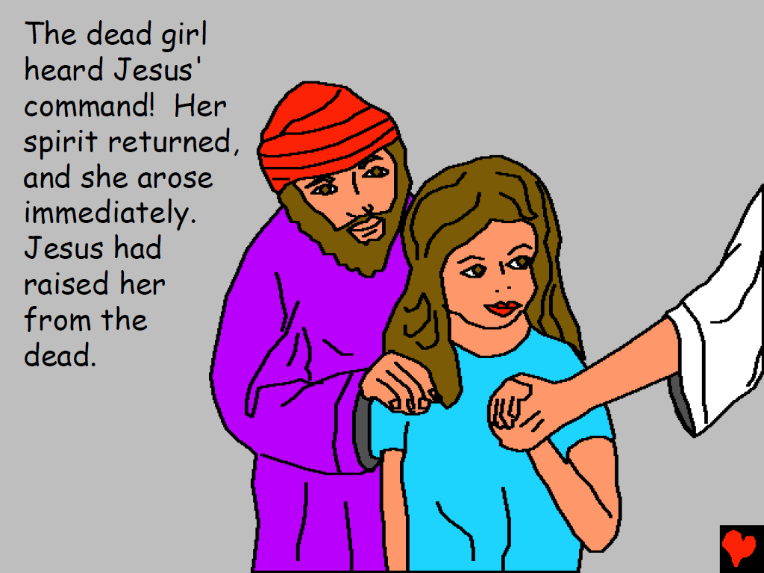

Slide 16
Video: The Raising of Jairus’ Daughter
Download Here:
https://www.youtube.com/watch?v=z5dV2v1Cvu4

Slide 17
Questions
1.Who came to Jesus and fell at His feet?
2. What did Jairus ask Jesus to do?
3. Why did the woman want to touch Jesus’ clothes?
4. What happened when she touched Jesus’ clothes?
5. How did Jesus treat the woman who was healed?

Slide 18
6. What was the news that someone from Jairus’ house brought?
7. How did Jesus show His mighty power and love for Jairus and his family?
8. What are you asking God to do that He has not answered yet?
9. How can you encourage others by what God has done for you?

Slide 19
Song: If I could Touch the Hem of His Garment Download Here: http://www.youtube.com/watch?v=mLqhTTjn4SA&feature=youtu.be

Slide 20
Note: Any videos in this presentation will only play online. After you download the slideshow, you will need to also download the videos from YouTube & add them back into your PowerPoint.
We present these messages at Bee Creek Park in College Station, TX. If you would like to watch the video of the service with this message, click here:
http://campaignkerusso.org
We would love to know more about the people who download our lessons & sermons. We invite you to email us & let us know where & how you use them.
info@ckbrazos.org

Slide 21
What is the Sinner‘s Prayer?
This is a prayer we can pray when we are ready to admit we are sinners and need Christ’s forgiveness.
It must be prayed with faith in our hearts and a readiness to have a life-changing encounter with Jesus Christ.

Slide 23
John Wesley’s Testimony
“…the preacher was describing the change which God works in the heart through faith in Christ and I felt my heart strangely warmed.”
Disciple’s Testimony
“They said to each other, ‘Did not our hearts burn within us while he talked to us on the road, while he opened to us the Scriptures?’”

Slide 24
A prayer of faith → Pray this prayer if :
If you never have before
You have in the past, but you think it would mean more today
You have been walking afar off and you want to come back
You want to set an example & show others how it is done
You just like to give your heart to Jesus again & again
Faith

Slide 25
We Declare Our Faith Publicly Because Jesus Declared His LOVE Publicly
“If you stand before others and are willing to say you believe in me, then I will tell my Father in heaven that you belong to me.” Mat 10:32

Slide 26
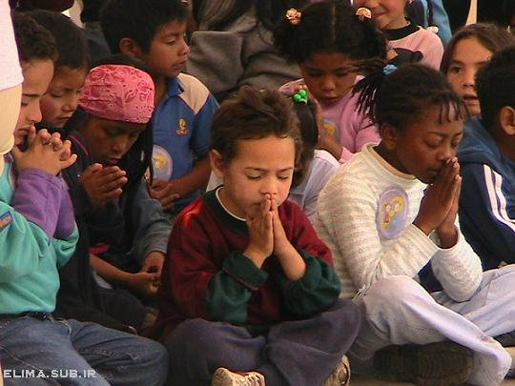
Dear Jesus,
I know I am a sinner & need your forgiveness.
I believe you died for my sins.
I now turn from sin.
Come into my heart I pray.
Do you want to meet Jesus as your savior right now?
Do you believe He died to save you from your sins & that He rose from the dead?
Do you believe that He is waiting to save you right now?

Slide 27
“But some people did accept him. They believed in him, and he gave them the right to become children of God.” John 1:12

Slide 29
“If you openly say, ‘Jesus is Lord’ and believe in your heart that God raised him from death, you will be saved.”
Rom. 10:9
What did you learn today?
What is the meaning of the name-tag?
What have you neen thinking about God lately?
What do you want to tell the world about Jesus?

Slide 30
“Draw near to God, and He will draw near to you…
…Cleanse your hands, you sinners, and make your hearts pure, you who are half-hearted towards God.” James 4:8 WNT

Slide 31
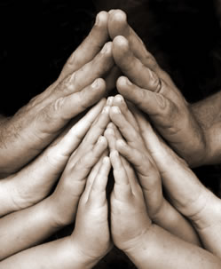
Close in Prayer

Slide 32
Note: Any videos in this presentation will only play online. After you download the slideshow, you will need to also download the videos from YouTube & add them back into your PowerPoint.
We present these messages at Bee Creek Park in College Station, TX. If you would like to watch the video of the service with this message, click here:
http://campaignkerusso.org
We would love to know more about the people who download our lessons & sermons. We invite you to email us & let us know where & how you use them.
info@ckbrazos.org

Slide 33
Welcome to Aggieland Faith Family Style Worship

Slide 34
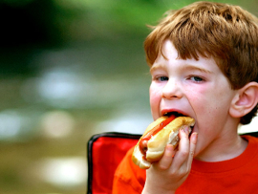
CURRENT SCHEDULE: See www.Aggielandfaith.org
SATURDAY —
At Bee Creek Park
2:00-4:00pm: Through the bible with felt-board stories – plus hot-dogs & drinks
SUNDAY —
At Bee Creek Park
2:00-4pm: Free snacks, drinks, kids crafts, prizes, singing & bible preaching

Slide 35
Would You Like Prayer or Bible Study at Your House?
Personal Prayer: We can come to your home & pray with you, or you can email us when you need prayer.
Home Bible Study: We will come to your home & hold a bible study for you & your friends.
Bible Party: We will hold a Kid’s Bible Party: You provide the food & kids - we will do the bible fun & stories.

Slide 36
Would You Like Visitation?
We will visit a friend, loved one in the hospital or in prison to pray for them & share Christ with them.
Contact: info@aggielandfaith.org

Slide 37
www.aggielandfaith.org
Go here to see pictures & videos
Go here to subscribe to e-mails about changes & cancellations

Slide 38
Note: Any videos in this presentation will only play online. After you download the slideshow, you will need to also download the videos from YouTube & add them back into your PowerPoint.
We present these messages at Bee Creek Park in College Station, TX. If you would like to watch the video of the service with this message, click here:
http://campaignkerusso.org
We would love to know more about the people who download our lessons & sermons. We invite you to email us & let us know where & how you use them.
info@ckbrazos.org

